Slide 1
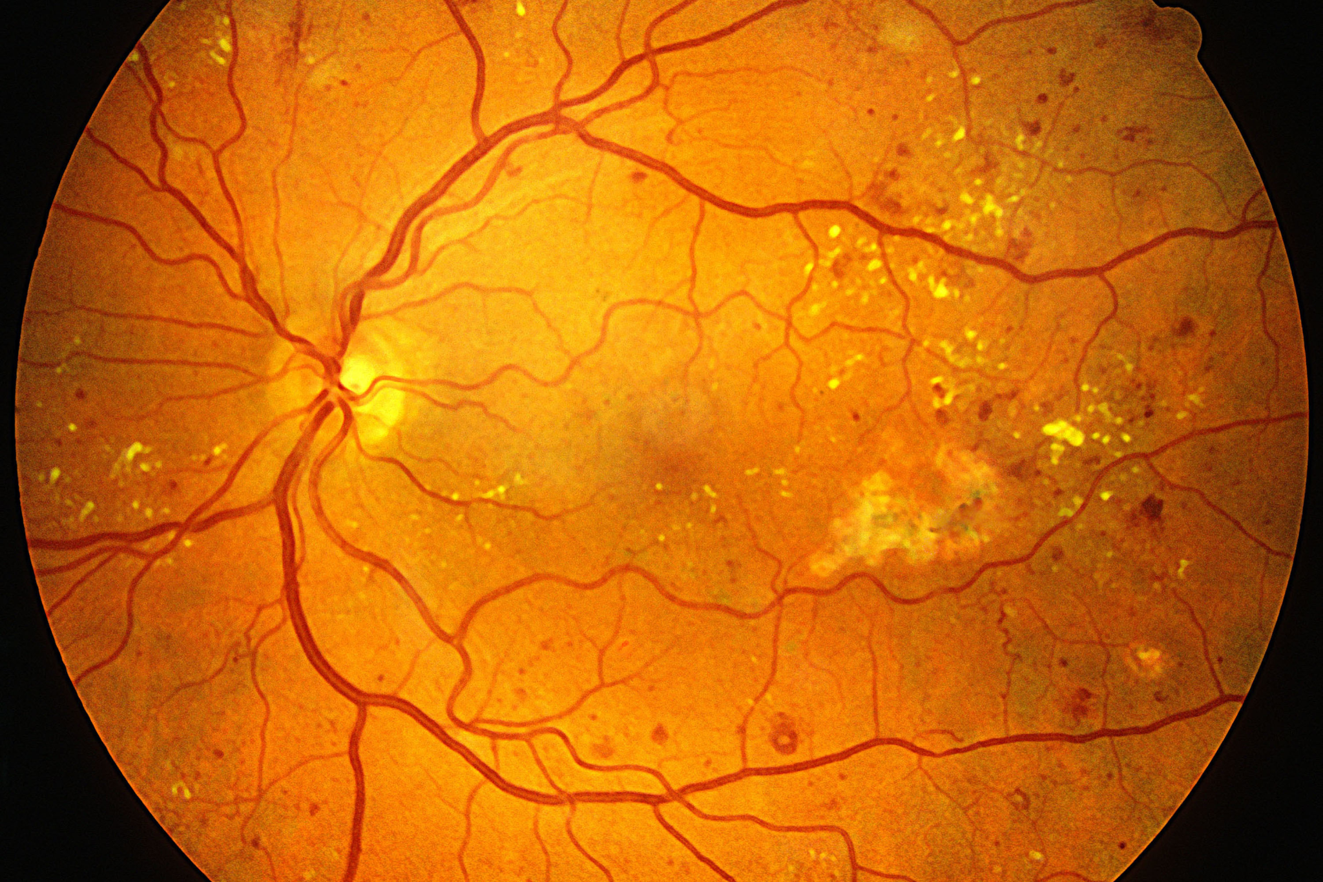
DIABETIC RETINOPATHY DETECTION
Group 23
210070015
210070017
21d070022
21d070083

Slide 2
Introduction
Diabetic Retinopathy (DR) is a common complication of diabetes mellitus, which causes lesions on the retina that affect vision. It is the leading cause of blindness among working age adults worldwide.
Mild DR is the early stage of DR, which is characterized by the presence of microaneurysms.
Proliferative DR (PDR) is the more advanced stage of DR and can result in severe vision loss.
Regular screening is important so that timely treatment can be implemented to prevent vision loss.
Manual diagnosis process of analysis of DR retina fundus images by ophthalmologists in time and cost consuming and leads to misdiagnosis more often computer-aided processes.
Recently, deep learning has started playing a major role in the field of medical image analysis and diabetic retinopathy is a crucial one among them.
Convolutional Neural Networks are widely implemented on this project to meet the demands and diagnose Diabetic Retinopathy accurately.

Slide 3
Problem Statement
There is a huge need for a comprehensive and automated method of Diabetic Retinopathy screening using image classification, pattern recognition, and machine learning. With color fundus photography as input, the goal is to ideally produce models with realistic clinical potential. Rating has to be provided on a scale of 0-4 based on the presence and extent of diabetic retinopathy. The ratings are as follows:
0. No DR
1. Mild DR
2. Moderate
3. Severe
4. Proliferative DR

Slide 4
Dataset Details
A large set of high-resolution of retina images is available which are taken under a variety of conditions. A left and right view is provided for every subject. Images are labelled with a subject id as well as either left or right.
Some images are shown as they would be visible anatomically (macula on left and optical nerve on right) and others are seen as if through a microscope condensing lens (inverted image).
The images in the dataset come from different models and different type of cameras which affect the visual appearance of left vs right eyes. The image may also be inverted.
We would encounter noise in both the images and their labels. They may be out of focus, underexposed or overexposed. This also needs to be taken into account.
The dataset needs to labelled out of the 5 classes from 0-4 as explained in the previous slide.

Slide 5
Literature Review
The following research papers were scrutinized by us as a precursor to solving the problem, the two papers summarize an attempt to create a deep learning model for detecting diabetic retinopathy across the disease spectrum.
Here’s the link to the articles:
https://doi.org/10.1038/s41467-021-23458-5
https://www.sciencedirect.com/science/article/pii/S2352914820302069

Slide 6
Literature Review : Introduction
Retinal screening contributes to early detection of diabetic retinopathy and timely treatment. To facilitate the screening process, the authors developed a deep learning system, named DeepDR, that can detect early-to-late stages of diabetic retinopathy.
Current deep learning systems for DR screening have been predominantly focused on the identification of patients with referable DR (moderate NPDR or worse) or vision-threatening DR, which means the patients should be referred to ophthalmologists for treatment or closer follow-up.
However, the integration of deep learning advances into DR screening is not straightforward because of some challenges. First, there are a few end-to-end and multi-task learning methods that can share the multi-scale features extracted from convolutional layers for correlated tasks, and further improve the performance of DR grading based on the lesion detection and segmentation, due to the fact that DR grading inherently relies on the global presence and distribution of the DR lesions

Slide 7
Literature Review : Methods
Retinal photographs were captured using desktop retinal cameras from Canon, Topcon, and ZEISS. All the fundus cameras were qualified by the organizer to ensure enough quality for DR grading.
DR severity was graded into five levels (non-DR, mild NPDR, moderate NPDR, severe NPDR, or PDR, respectively), according to the International Clinical Diabetic Retinopathy Disease Severity Scale (AAO, October 2002).
Mild NPDR was defined as the presence of microaneurysms only. Moderate NPDR was defined as more than just microaneurysms but less than severe NPDR, presenting CWS, hard exudates, and/or retinal hemorrhages.
Severe NPDR was defined as any of the following: more than 20 intraretinal hemorrhages in each of the 4 quadrants; definite venous beading in 2+ quadrants; prominent intraretinal microvascular abnormalities (IRMA) in 1+ quadrant, and no signs of PDR.
PDR was defined as one or more of the following: neovascularization, vitreous/preretinal hemorrhage.
DME(Diabetic Macular Edema) was diagnosed if hard exudates were detected within 500 μm of the macular center according to the standard of the Early Treatment for Diabetic Retinopathy study. Referable DR was defined as moderate NPDR or worse, DME, or both.

Slide 8
Literature Review : Methods
The DeepDR system had three sub-networks: image quality assessment sub-network, lesion-aware sub-network, and DR grading sub-network. Those sub-networks were developed based on ResNet41 and Mask-RCNN.
Both ResNet and Mask-RCNN could be divided into two parts: (1) feature extractor, which took images as input and output features, (2) task-specific header, which took the features as input and generated task-specific outputs (i.e., classification or segmentation).
Specifically, the authors chose to use the Mask-RCNN and ResNet with the same feature extractor architecture, so the feature extractor of one sub-network can be easily transferred to another.
The quality assessment sub-network can identify overall quality including gradability, artifacts, clarity, and field issues for the input images.
The lesion-aware sub-network can generate lesion presence and lesion segmentation masks of the input images. There were two modules in our lesion- aware sub-network: one was the lesion detection module and the other was the lesion segmentation module.
The DR grading sub-network can fuse features from lesion-aware network and generate final DR grading results. To retain as much lesion information from the original retinal image as possible, we combined the pre-trained DR base network with the feature extractor of the lesion segmentation module in order to capture more detailed lesion features for DR grading.

Slide 9
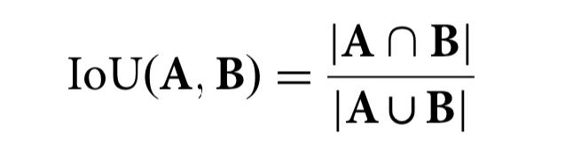
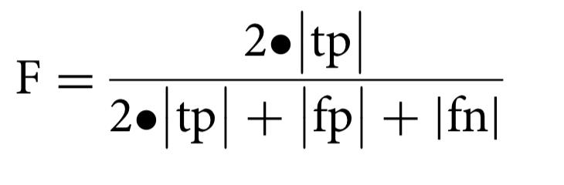
Literature Review : Methods
The performances of DeepDR in assessing image quality, retinal lesion detection, and grading DR were measured by the AUC of the receiver operating characteristic curve generated by plotting sensitivity (the true-positive rate) versus 1-specificity (the false-negative rate).
For lesion detection, AUC was calculated as a binary classification to determine if a quadrant contained a certain kind of lesion. The performance of lesion segmentation was measured by IoU and F- score.
The IoU was calculated as:
For microaneurysms, the F-score was used instead of the IoU score, The F-score was calculated as:

Slide 10
Literature Review : Results
DeepDR achieved an AUC of 0.934 (0.929–0.938) for overall image quality. For the identification of artifacts, clarity, and field definition issues, the system achieved AUCs of 0.938 (0.932–0.943), 0.920 (0.914–0.926), and 0.968 (0.962–0.973), respectively.
The lesion-aware sub-network was evaluated using 4621 gradable images with retinal lesion annotations from the local validation dataset.
For microaneurysm, the AUC, sensitivity, specificity, and F-score were 0.901 (0.894–0.906), 88.0% (87.2–88.9%), 73.3% (72.0–74.3%), and 0.815, respectively.
For CWS, the AUC, sensitivity, specificity, and IoU were 0.941 (0.935- 0.946), 90.0% (87.9-91.9%), 83.1% (82.2–83.9%), and 0.711, respectively.
For hard exudate, the AUC, sensitivity, specificity, and IoU were 0.954 (0.949–0.957), 90.5% (88.9–91.5%), 85.8% (85.2–86.6%), and 0.971, respectively.
For hemorrhage, the AUC, sensitivity, specificity, and IoU were 0.967 (0.965–0.969), 93.2% (92.6–94.1%), 88.0% (87.6–88.7%), and 0.738, respectively.
On external validation datasets, the DeepDR system achieved AUCs of 0.916 (0.912–0.920) for mild NPDR, 0.927 (0.925–0.929) for moderate NPDR, 0.962 (0.959–0.965) for severe NPDR, and 0.955 (0.949–0.961) for PDR.

Slide 11
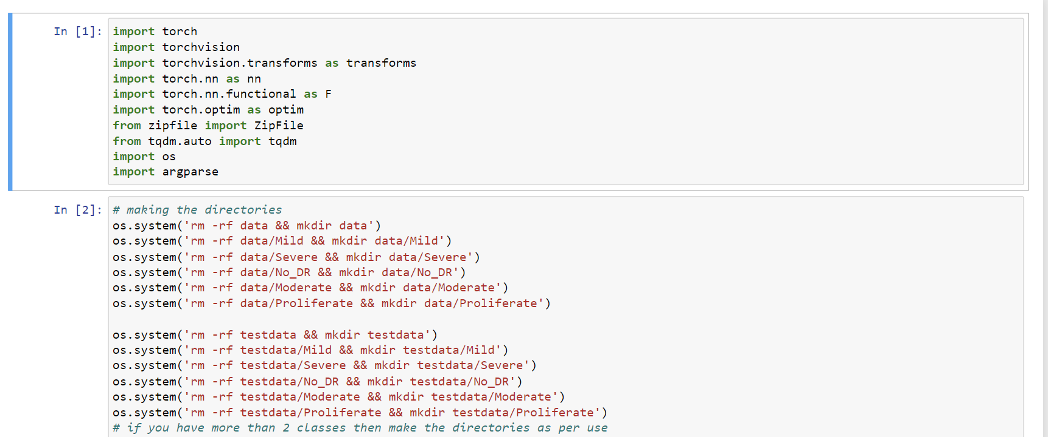
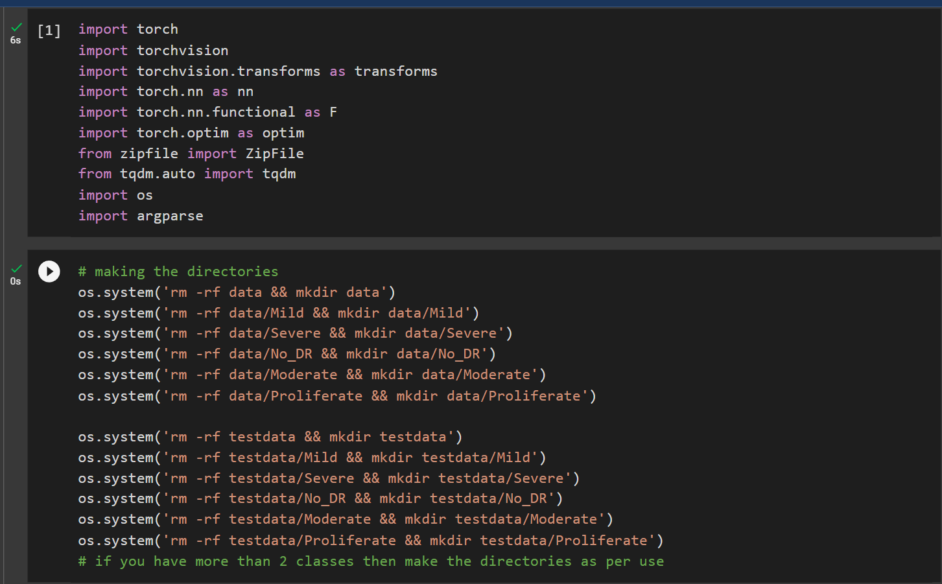
Code Explanation
Made use of Pytorch to test for more efficient implementation than Tensorflow
Torchvision and .nn method were used which providing us set of basic functions and dataloaders required to execute deep learning using Pytorch.
os.system was used to make directories to store the train and testing images locally in google colab

Slide 12
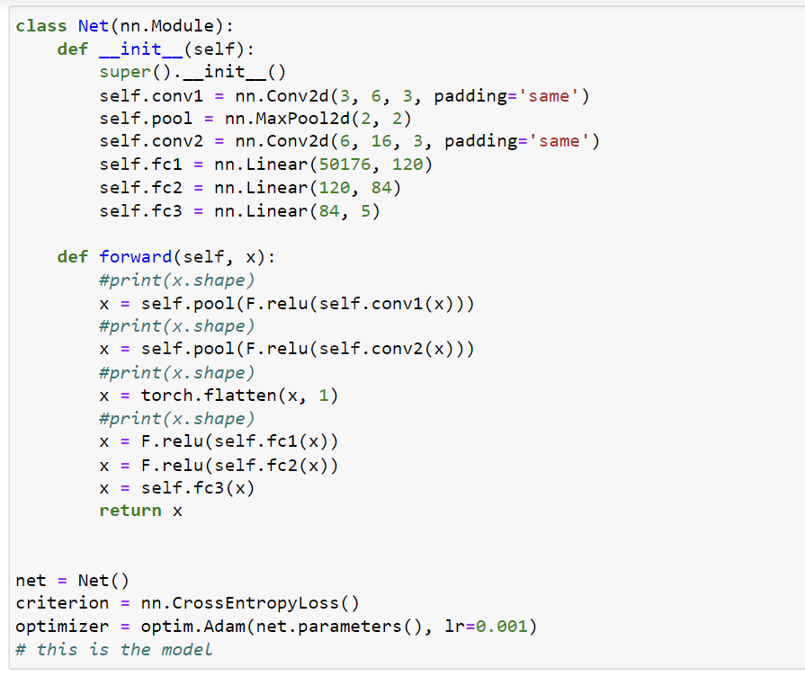
We decided to work with a basic model
The image dimensions are 224*224.
Padding is same so after convolution the first 2 dimensions will be same and number of output channels change. Max pooling by (2,2) so we divide by 4 dimension.
First we defined the common layers and operations in Deep learning. Then the forward propagation or the flow of data was designed in the forward function.

Slide 13
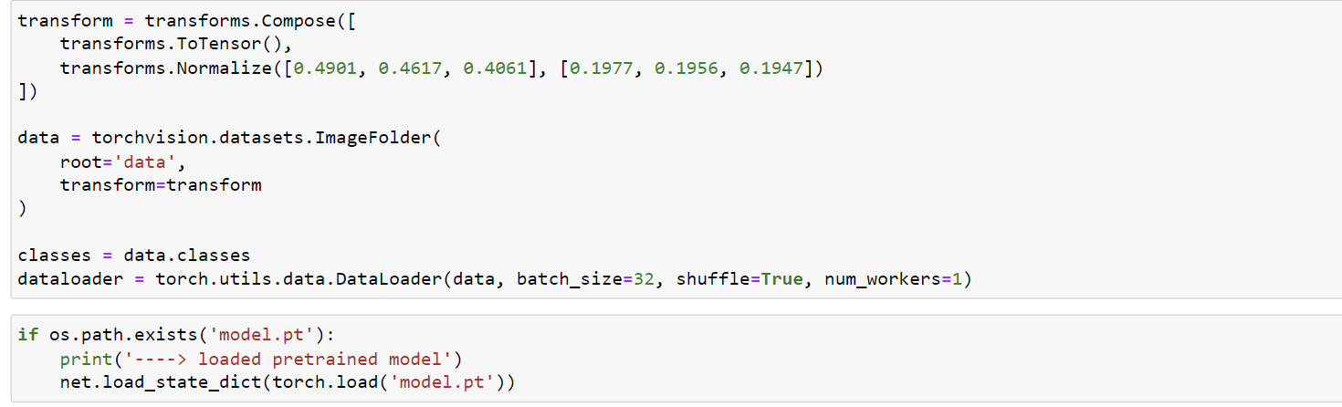
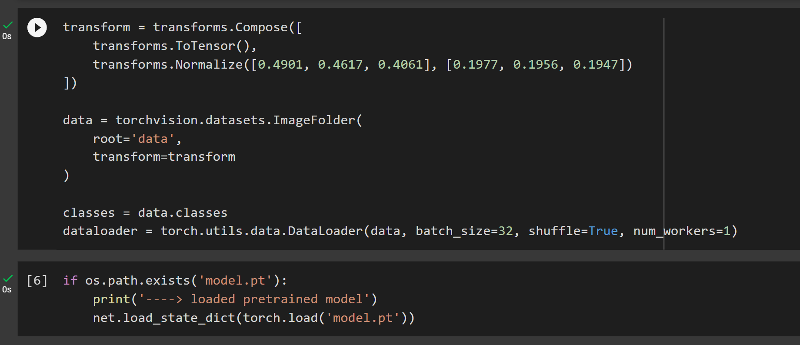
So basically we now import the images from our devices to local python environment and using ‘transform’ we tried to introduce randomness and variation into the training data, which can help prevent overfitting and improve the generalization performance of the model.
We are working with less training and testing images for faster hyperparameter tuning and visualisation.
Due to large training time, we use the load-save method for training our weights so that the progress is not lost due to power connection loss

Slide 14
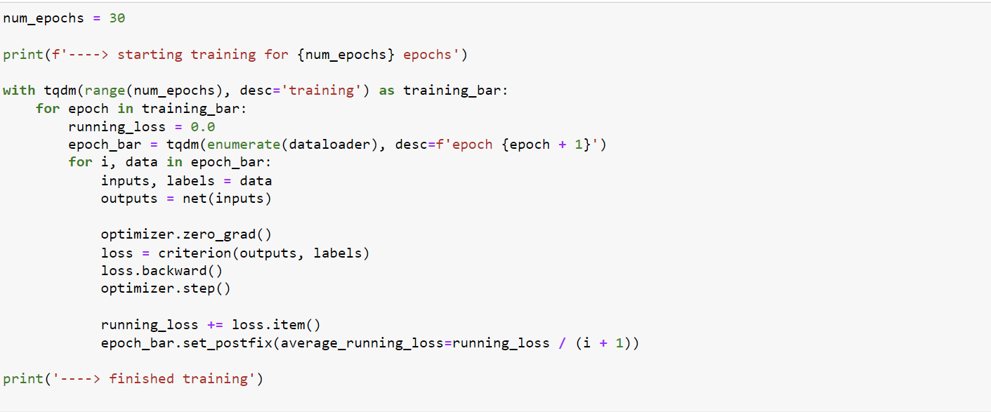
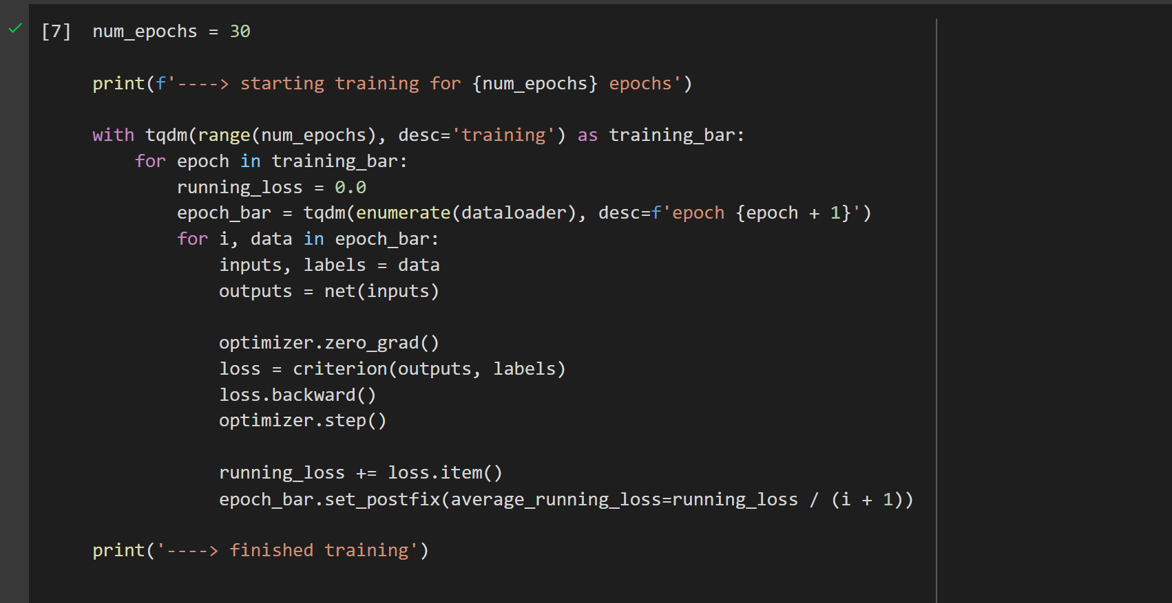
This code snippets is used for training our dataset.
Back propagation was not done explicitly as pytorch functions are designed to them automatically.
Tqdm module and running loss function are used to help easily visualise the training using a progress bar and show average running loss to track the loss.

Slide 15
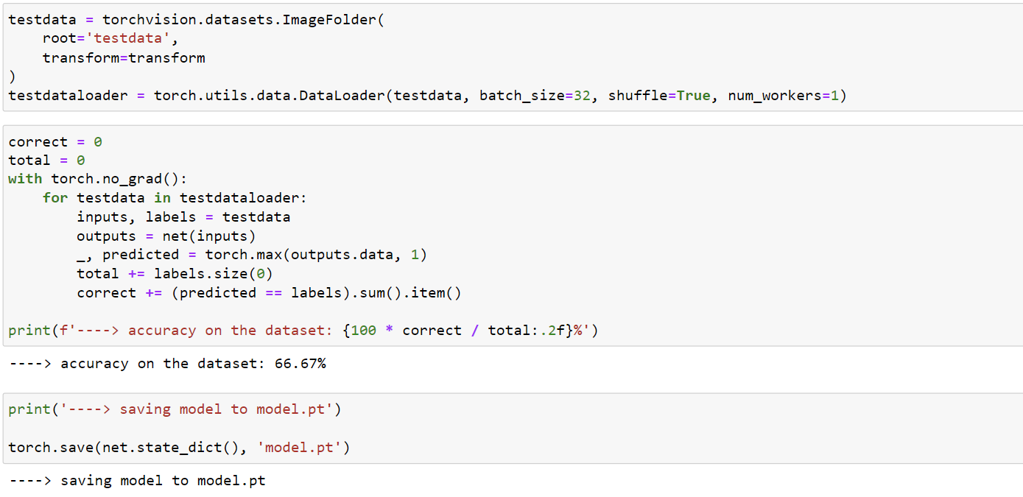
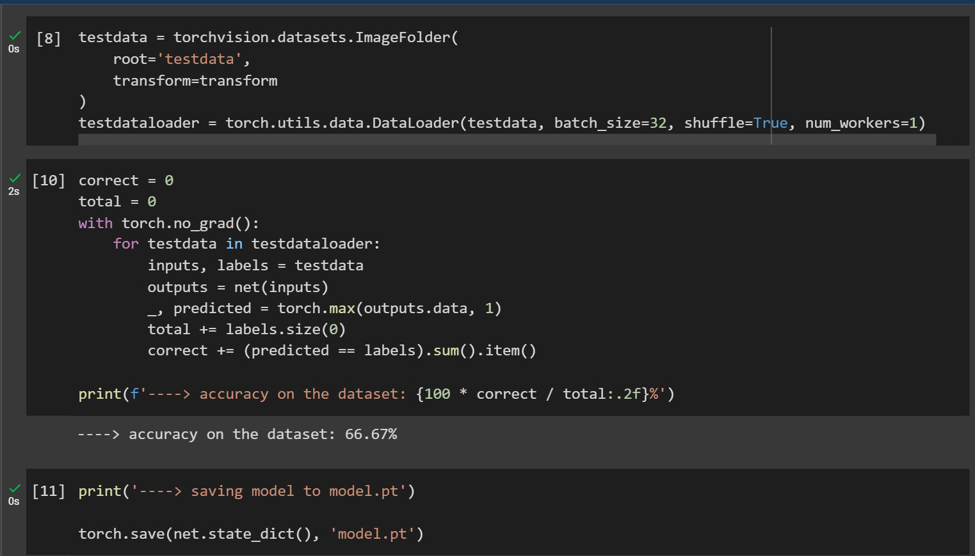
The same process for loading datasets from local directory in batches of 32 was done for the test images
The next code snippet was used to compute the predicted class labels for a batch of input samples using the output predictions from the model and finally give the result as a percentage
By using more image data and more epochs, we will be able to get a more accurate model.

Slide 16
Conclusions
Deep Learning Convolutional Neural Network models result in best accuracy among all other available models for the following reasons:
We limited the max norm (absolute value) of the weights for certain layers in order to generalize our model.
The first layer was obviously frozen because it intends to capture shapes and features.
The effectiveness of an ML algorithm is highly dependent on the integrity of the input-data representation, hence DL models were preferable

Slide 17
Individual Contributions
Avaneesh: Contributed in the presentation and did literature review
Ayushh: Made the code, contributed in the presentation and the report
Deep: Contributed in the report and finding the datasets
Umang: Made the presentation, contributed in the code, report

Slide 18
THANK YOU
BY-
Avaneesh Sai Subramanyam
Ayushh Garg
Deep Boliya
Umang Agarwal

